Slide 1
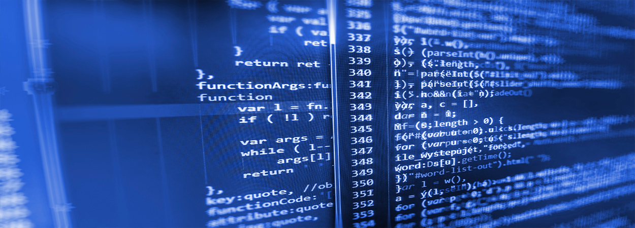
Burn wound healing model
Mark de Boer
Ben Dickens

Slide 2
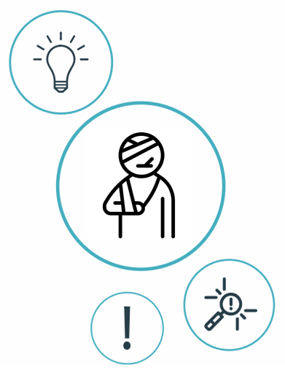
Index
Introduction
Previously built models
Proposal
Possible biomarkers
Possible sociomarkers
Data available?

Slide 3
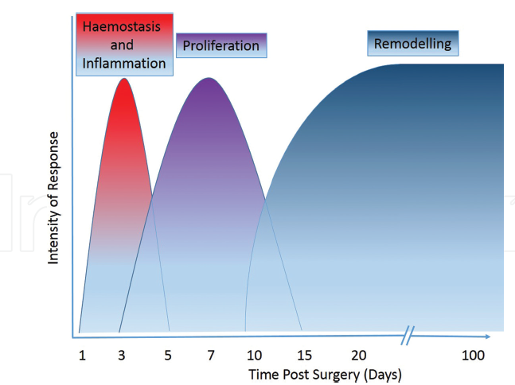
Stages of healing
Commonly divided into four overlapping stages.
release growth factors and chemokines into the local wound environment (chemotactic signals such as TGF-β and PDGF).
early inflammatory response mobilises local and systemic
Inflammatory response is fundamental to the healing process:
Fight infection, clear debris and induce the proliferation phase <-> Tissue damage
Notes:
Inflammation helps, clear debris and induce the proliferation phase (fibroblasts entering, then angiogenesis), but may lead to tissue damage if it lasts too long. This is often the case when: unable to clear debris, excessive detritus, devitalised tissue, or microbial biofilm is present.

Slide 4
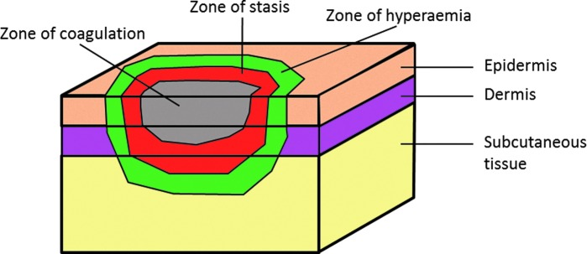
We can get rid of this slide or be much more specific about what happens to the dermis and epidermis (necrosis, ischemia, stem cell hair follicles destroyed, coagulation, ITMs in blood stream etc) during a severe 2nd or 3rd degree burn (especially for AP/immunology expert).
Zones of injury
Burns consist of three zones of injury
Main difference from cuteanous wounds is the the loss of the skin appendages and re-epithelialization, which can only occur from the edges of the wound.
Deep (third degree) burns are so serious largely because they destroy the many hair follicles and sweat glands that invaginate deep into the dermis and serve as efficient sources of epithelial regrowth after more superficial injury.

Slide 5
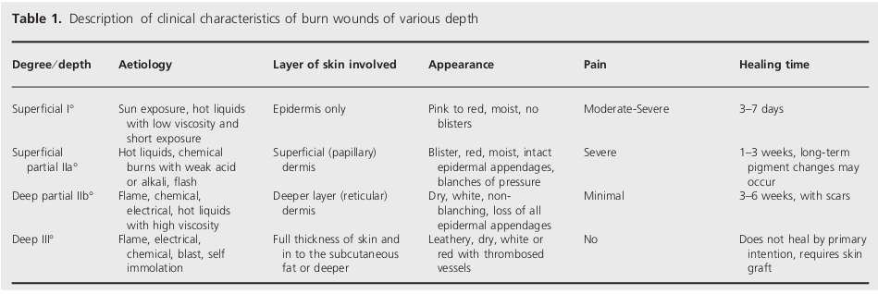
Burn wounds are variable,
or

Slide 6

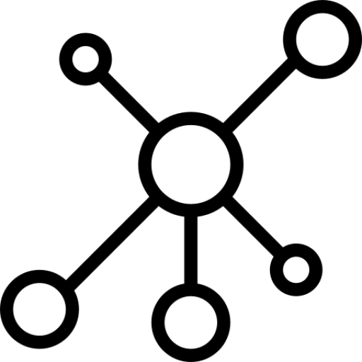
Previously built models
Dynamic ABM/EBM computational frameworks simulating
cutaneous wound healing (Inflammation, Proliferation, Remodeling)
Dynamic EBM computational Alkaline Phosphatase (AP) models
to study the immune response process in wound healing.
Notes:
Perfect skin regeneration of burn wounds remains a challenge. There is still a lack of fundamental understanding of the interactions between different cell types, complex cell signalling networks and mechanical feedback loops during the wound healing process. Previous efforts have focused on constructing dynamic computational frameworks simulating cutaneous wound healing [1,2,3], but have not focused on burn wound healing.
In addition, dynamic computational models have been used to study the inflammation process in wound healing. Presbitero et al. [4] constructed a validated numerical systemic inflammation model under clinical treatment conditions of the Alkaline Phosphatase enzyme. Alkaline phosphatase (AP) exhibits anti-inflammatory effects by dephosphorylating inflammation triggering moieties (ITMs) like bacterial lipopolysaccharides and extracellular nucleotides.
These models are all not burn wound specific, therefore adjustments or an expansion of these models are demanded, to simulate the burn wound procedure. The link between the AP model and the cutaneous wound healing models, has not been investigated/found yet. By first performing a literature review focused on possible connections, this will be investigated. Constructing a computational model simulating burn wound healing would be a step forward towards a better understanding of dynamical adaptation to heal burn wounds.
ABM: simulating the actions and interactions of autonomous agents (both individual or collective entities such as organizations or groups) with a view to assessing their effects on the system as a whole

Slide 7
The AP model

Slide 8
There are several validated models which simulate one or two of the phases of wound healing. Almost all of these models use the same cell populations as the AP model, e.g. pro/anti inflammatory cytokines, activated/resting macrophages etc. However, these models only consider the immune system indirectly, while usually explicitly referring to the specific cytokines that activated macrophages release such as TGF-β, TNF-α and interleukins.
Several of the papers, have validated collagen deposit rates in the presence of inflammatory signals and chemokines, but rely on accurate tissue and blood composition. Essentially, if we can connect the immune system to the specific cytokines involved in almost all aspects of the healing process (TGFB,FGF,PDGF, VEGF, TNFa, IL), much of the legwork has actually been done by these papers.
If we can integrate the AP model with inflammation models that refer to specific cytokines and validate this, extending the model for the proliferation, contraction, and re-epitheliasation should not pose too much of an issue. Angiogenesis may prove more of a challenge, however, may be crucial to capture the exposure to the blood supply (and therefore HIIS co-evolution).

Slide 9
TGF-beta
It is part of almost all processes of wound healing except angiogenesis, and will perhaps be the lynchpin of our model, getting its dynamics, interactions and levels validated and realistic in relation to the HIIS, is crucial for most stages of healing..
TGF-β (multifunctional cytokine)
Released by macrophages
Attracts macrophages and fibroblasts
Stimulates resting monocytes – upregulates inflammatory response
While also downregulating cytokine production in monocytes and macrophages
inhibits activated macrophages
Excessive action may be responsible for tissue damage from scarring
Maybe talk about some other key cytokines here ...

Slide 10
We can add photos of the particular phase to the slides going through the different phases of healing with their respective model.
Discussing these models, what they measure, how they relate to the AP model, their results and validation should form the meat of the presentation.
Specifically, as far as I can tell, every phase of healing is connected to the immune system but no other papers have modeled this relationship. If we have a validated model connecting AP to any phase of wound healing, is essentially novel research but the inflammation phase is intuitively the best place to start. We should seriously think about how we would be able to validate this though, although the original paper is directly concerned with inflammation (although a different type than that found in wound healing)

Slide 11
Tepole et al. ~
Computational modeling of chemo-bio-mechanical
Coupling toward
wound healing
Flegg et al. ~
On the mathematical modeling of wound healing angiogenesis
Boon et al. ~
A multi-agent cell-based model for wound contraction
Li et al. 2011 ~ Biosimulation of Acute Phonotrauma: an Extended Model
2011
2014
2015
2016
2007
2013
2017
2018
Mi et al. ~
Agent-based model of inflammation and wound healing
Ziraldo et al. ~
Computational Modeling of Inflammation and Wound Healing
Tepole et al. ~
Computational systems mechanobiology of Wound Healing
Sloot et al. ~
Alkaline Phospatase and it’s role in the Immune System

Slide 12
Ziraldo et al. 2013 ~ Computational Modeling of Inflammation and Wound Healing
SPARK-PL (Java)
2-Dimensional ABM model
Inflammation
Relevant cell populations:
Endothelial cells
Macrophages
Neutrophils
Fibroblasts
Key effector cytokines :
TNF-α
IL-1β
IL-10T
TGF-β1

Slide 13
Li et al. 2011 ~ Biosimulation of Acute Phonotrauma: an Extended Model
2-Dimensional ABM model
Inflammation + synthesis of collagen/elastin (link to contraction)
Relevant cell populations:
Platelets
Macrophages
Neutrophils
Fibroblasts
Fibres:
Collagen
Elastin
Key effector cytokines :
TNF-α
IL-1/6/8/10
TGF-β1
bFGF

Slide 14
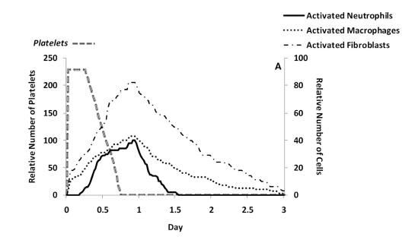
Predicted cell trajectories for platelets, activated neutrophils, activated macrophages and activated fibroblasts.
Predicted ECM trajectories for new
collagen, new elastin and new hyaluronan

Slide 15
Boon et al. 2016 ~ A multi-agent cell-based model for wound contraction
Matlab
3-Dimensional multi-agent cell-based hybrid model
Contraction (The mechanical pulling of (myo-)fibroblasts on the ECM)
Relevant cell populations:
Leukocytes (to simplify
Fibroblasts
myofibroblasts
Fibres:
Collagen
Fibrin
Key effector Cytokines/ Chemokines :
tPA
PDGF
TGF-β
Notes:
Themodelisbasedonacell-basedformalism where fibroblasts, myofibroblasts andtheimmunereactionaretakenintoaccount.Themodelisusedto simulate contractionofawoundusingpointforcesonthecellboundar nthisprocess,thecellsadheretotheextracellular matrix (orECM).TheECMisco
mprisedmostlyofcollagen fibrils yanditalsodeterminesthe orientation ofcollagenafterrestorationofthedamage.
These aspects included cellspeed, flux, polarisation, density, initial matrix orientation and the influence of cells on the matrix.
Cleaning function of leukocytes not incorporated.
tPA (fibrin decay), PDGF (leukocytes atraction), TGFB (attraction fibroblasts)
Therefore,we assume that the cell migration speed decreases as they move deeper away into the wound area.The reason for this is that the cells less easily find rigid spots to adhere to in the loosely connected regions.

Slide 16
3D Fibrin profiles at consecutive times for t=0h, t=1h, t=2h and t=5 h.
Also for Collagen/ TGF

Slide 17
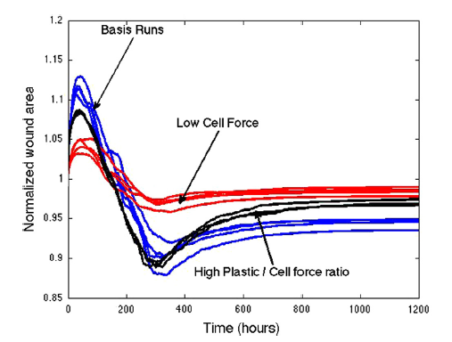
One of the most problematic issues regarding severe burns or deep wounds is the permanent contraction of the wound.
Notes:
Fibroblasts located outside the wounds -> in undamaged tissue so first expands, cause already pulling
Fibroblasts into the wound

Slide 18
Tepole et al. 2017 ~ Computational systems mechanobiology of Wound Healing
2-Dimensional EBM model
Proliferation and Remodeling
Modeling Angiogenesis, Contraction and Re-epithelialization
Including changes in relevant cell populations (Endothelial cells, Macrophages, Fibroblasts, Myofibroblasts, Keratinocytes) and their key effector cytokines (TGF-α, FGF-7, PDGF, TGF-β1, FGF(1,2,4), VEGF), and mechanical loads

Slide 19


Research Questions + Aim:
What causes a better healing of burn wounds?
What is the link between the AP model and the cutaneous wound healing model?
A novel computational framework combining the AP and ABM models
to simulate the healing of burn wounds

Slide 20

Proposal
Discrete Spatio-temporal (existing in both space and time) Agent-Based Model combining both the immune response model and the ABM wound healing models
The AP model will act like an engine for the blood composition of a 2/3-dimensional ABM model.

Slide 21
Approaches
Possibly try measuring what kinds of anti and pro inflammatories are in the wound and
blood stream after a severe burn, configure our abm like this then take proportions of
cytokines back from the hiis model after calculating how the immune system is
affected and responds to that balance of cytokines in the bloodstream, rinse repeat.
Later, this co-evolution scales with exposure to blood supply, for now leave constant.
We will attempt to configure a realistic/valid model of 2d wound inflammation and
immune system interaction, if we cannot capture dynamics, extend to 3d (this is a very
likely outcome). From here we can start experimenting and extending (once we have
a valid model).
Preferably measuring from the inside and outside areas of a burn for these
biomarkers.
Collecting data will give us a way of assessing what balances of cytokines is healthy
and leads to good outcomes, age is important too (e.g. the elderly scar less but heal
slower). This is a trend in amount of scarring. Hypothesise that anti tgfb ( which ap
could be through dephosharating macrophages and extracellular nucleotides that
produce tgfb???) Late in healing process modulation may lead to less scarring but
perhaps slower healing.

Slide 22
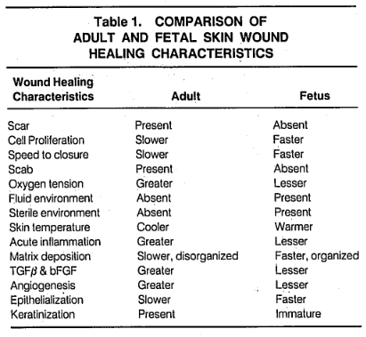
Modulation of AP may in fact work in this capacity. (“only” speculation until we validate model).
TGF-β Hypothesis
We (and others) hypothesise that anti-TGF-β therapies later in the healing process may lead to less scarring but slower healing.
Red deer antler (a traditional Chinese medicine) ointment found to modulate TGF-β levels and improve cutaneous wound healing outcomes in full-thickness rat models (Gu et al., 2008)
Scarring in adults associated with excessive action of TGF-β
Scarless fetal wounds are relatively deficient in the inflammatory cytokine TGFB (also sparse inflammatory response (reduced macrophage and monocyte infiltrates, absence of endogenous immunoglobulins at the wound site, reduced angiogenesis, and altered levels of peptide growth factors)
It appears that adult wounds may be optimised for speed of healing under adverse conditions, resulting in excessive inflammatory infiltrate and cytokine profile (Adzick and Lorenz, 1994)

Slide 23
The Biomarkers we would like to measure
I will add a table here with the biomarkers and some details about them

Slide 24
Inflammation Stages
Neutrophils are prevalent in the wound, they produce antimicrobial substances and phagocyte bacteria.
Second phase: Macrophages continue the immunological response to establish long-lasting chemical source of various cytokines to recruit fibroblasts, endothelial cells, and keratinocytes. TGF, FGF, PDGF, and VEGF are the key cytokines to stimulate mitosis (healthy cell division) and native skin cell migration.
Vascular response: Immediately after burns there is a local vasodilatation with extravasation of fluid in the third space. In extensive burn injury increased capillary permeability may be generalized leading to massive extravasation of plasma requiring fluid replacement.
Cellular response: Neutrophils and monocytes are the first cells to migrate at the site of inflammation. Later on neutrophils start declining and are replaced by macrophages. The migration of these cells is initiated by chemotactic factors like kallkireins and fibrin peptides released from coagulation process and substances released from the mast cells like tumour necrosis factor, histamine, proteases, leukotreins and cytokines. Cellular response helps in phagocytosis and cleaning of dead tissue and toxins released by the burned tissue.

Slide 25
Biochemical Changes in Burns – Adiga et Adiga, 2015
ALT AND AST
An increase in edema formation in burns patients may lead to cell damage, with the release of the hepatic enzymes. Liver enzymes, such as aspartate aminotransferase (AST) and alanine amino transferase (ALT) are the most sensitive indicators of hepatocyte injury. Both AST and ALT are normally present in low concentrations. However, with cellular injury or changes in cell membrane permeability, these enzymes leak into circulation. Of the two, the ALT is the more sensitive and specific test for hepatocyte injury. These enzymes may be predictors of prognosis in burns injury.

Slide 26
CRP and PCT
CRP is often used as a general proxy to characterise inflammatory status.
TNF-a
Initiating factor in the activation of the host response and subsequent cytokine release during trauma. Correlates with the severity of burn injury. Pro-angiogenic factor.
Leptin
Stimulated by pro-inflammatory cytokines (eg IL and TNFa). Cytokine-like hormone that links nutritional status with the immune system, while enhances innate(+adaptive) immunity. Related to regulation of stress. Pro-angiogenic factor.

Slide 27
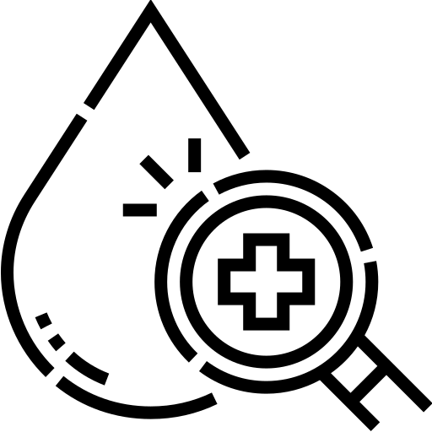
Blood Composition
Pro-inflammatory Cytokines:
IL-8
IL-6
IL-1β
TNF-α
Anti-inflammatory Cytokines
Interleukin 10 (IL-10)
IL-6
TGF-β
Other:
C-reactive protein (CRP)
Leptin
Neutrophils
Macrophages
TGF-α

Slide 28

Relevant parameters/markers
Geometrical Paramaters:
Length
Width
Depth of burn
Surface
Volume
Total Body surface area of burn (TBSA)
Burn Location/s
Body fat %
Tissue scattering, Location of hemoglobin molecules (High hemoglobin content in the zone of hyperemia)
Macromolecular collagen structure (native or denatured) [Optical Coherence tomography]??
Pigmentation
Burn Mechanism
Relevant Socio-markers
Age
Weight
Height
Gender

Slide 29
Plan for the Next 2 Weeks
Conceptualise the inflammation-immune 2D ABM (i.e. Cell populations, cytokines …) in general terms
Find all available data on blood, wound and immune composition and their interactions.

Slide 30

Data available?

Slide 31

Conclusion

Slide 32
Questions for Ruud
How much resolution (of the HIIS) is lost by grouping pro and anti inflammatory cytokines of the immune system?
To what extent would anti-inflammatory action undermine the signaling function of inflammatory cytokines?

Slide 33
Questions for Paul
To what extent does slowing the rate of healing increase the risk of infection and other complications? (how often are later stage complications genuinely problematic? Is it dangerous to try to minimise scarring?
What challenge is posed by skin grafting and what makes the grafting more successful (e.g. Does it the underlying fibrin/collagen make-up affect surgery)?
Which stage of wound healing process poses the greatest challenge for minimising damage/ maximising health outcomes?
Do you want us to look at grafted or non-grafted skin healing?

Slide 34
Questions for Both
“AP plays a key role in the maintenance and restoration of physiological barriers”
What kind of interests or priorities do you have, in terms of improving the burn healing process or understanding the interaction between the immune system and healing? (exploratory or focused? What kind of work would be most extendable and impactful in your opinion? What function would you like this research to fulfill?)

